Slide 1
Cisco Certified Network Associate
(CCNA)

Slide 2
Switching Concepts

Slide 3
Objectives
Introduction to Ethernet 802.3 LANs
Introduction to LAN switching
Switch operation

Slide 4
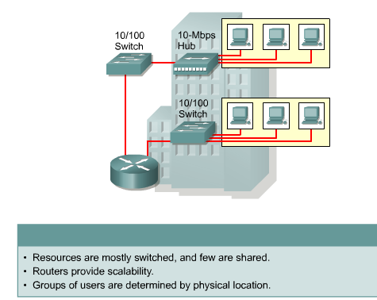
802.3 LAN Development: Today’s LANs

Slide 5
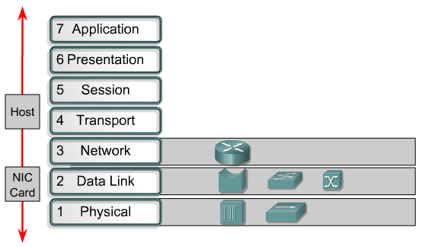
Devices Function at Layers

Slide 6
Factors that Impact Network Performance
Network traffic (congestion).
Multitasking desktop operating systems (Windows, UNIX, and Mac) allow simultaneous network transactions.
Faster desktop operating systems (Windows, UNIX, and Mac) can initiate faster network activity.
Increased number of client/server applications using shared network data.

Slide 7
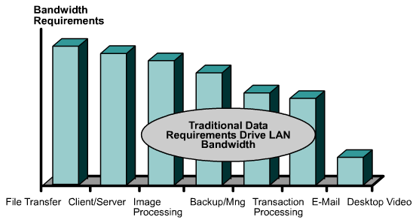
Typical Causes of Network Congestion

Slide 8
Ethernet 802.3
Performance of a shared-medium Ethernet/802.3 LANs is negatively affected by factors such as the following:
  The broadcast delivery nature of Ethernet.
  Carrier sense multiple access collision detect (CSMA/CD) access method allows only one host to transmit at a time.
  Multimedia applications with higher bandwidth demand such as video and the Internet.
  The latency of additional devices added by the extension of LANs by using repeaters.
  The distance added by using Layer 1 repeaters.

Slide 9
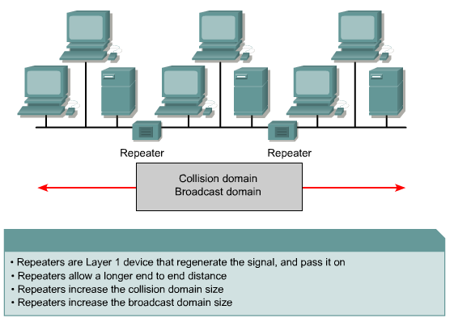
Benefits of Using Repeaters

Slide 10
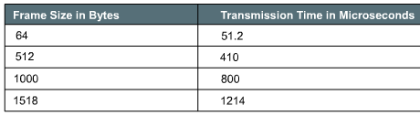
Ethernet 10BASE-T Transmission Times
Bit time (or slot time) — The basic unit of time in which 1 bit can be sent. For electronic or optical devices to recognize a binary 1 or 0, there is a minimum duration during which the bit is "on" or "off. "
Transmission time — Equals the number of bits being sent times the bit time for a given technology. Another way to think about transmission time is as the time it takes a frame to actually be transmitted. (Small frames take a shorter amount of time, large frames take a longer amount of time to be transmitted.)

Slide 11
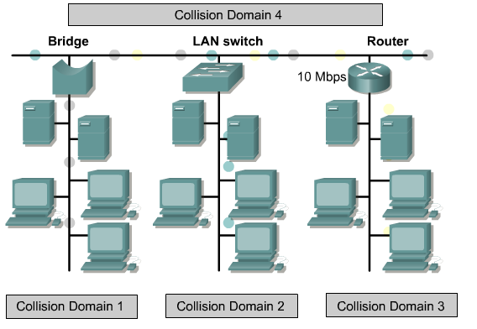
LAN Segmentation
Segmentation allows network congestion to be significantly reduced within each segment.

Slide 12
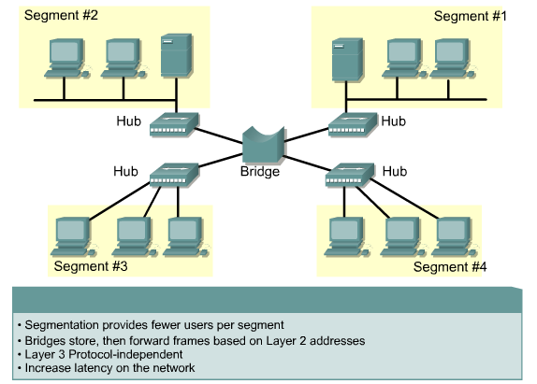
LAN Segmentation with Bridges

Slide 13
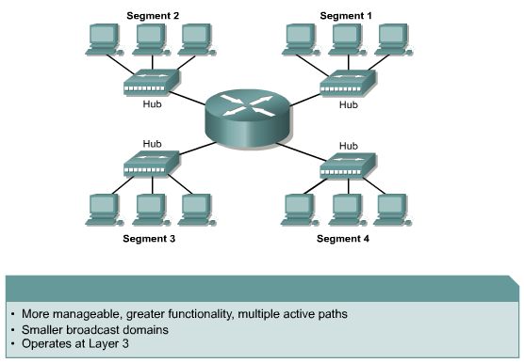
LAN Segmentation with Routers

Slide 14
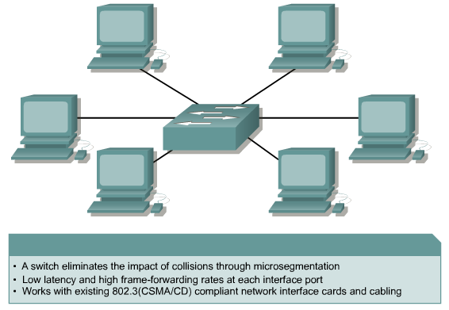
LAN Segmentation with Switches

Slide 15
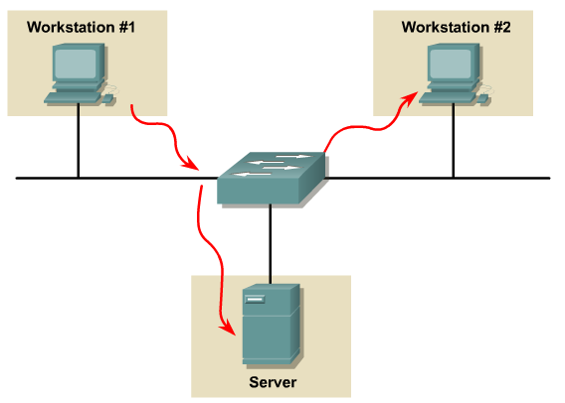
Ethernet Switch Latency

Slide 16
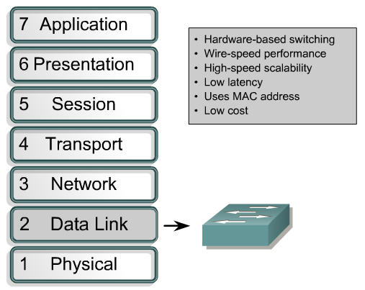
Layer 2 Switching

Slide 17
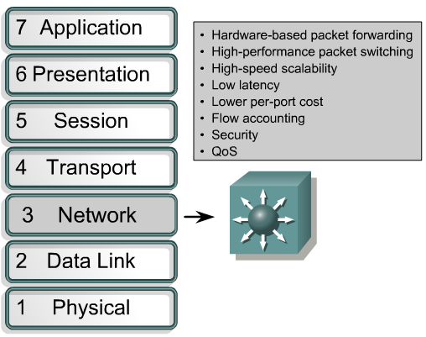
Layer 3 Switching

Slide 18
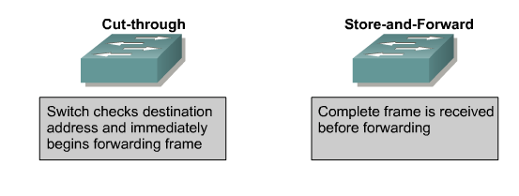
Two Switching Methods

Slide 19
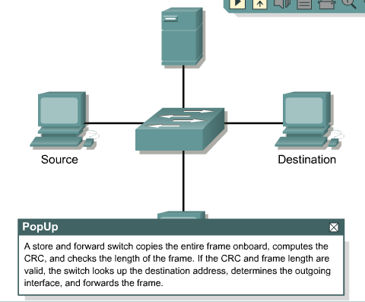
Store and Forward

Slide 20
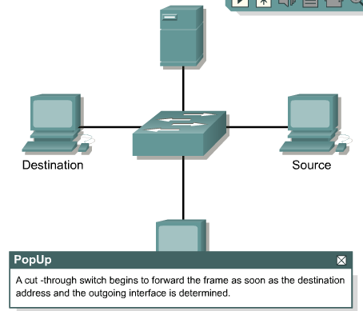
Cut Through

Slide 21
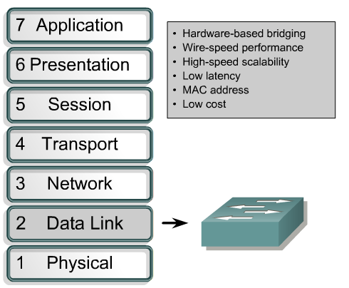
Functions of Ethernet Switches

Slide 22
How Switches and Bridges Filter Frames
Bridges and switches only forward frames, which need to travel from one LAN segment to another.
To accomplish this task, they must learn which devices are connected to which LAN segment.
Bridges are capable of filtering frames based on any Layer 2 fields.

Slide 23
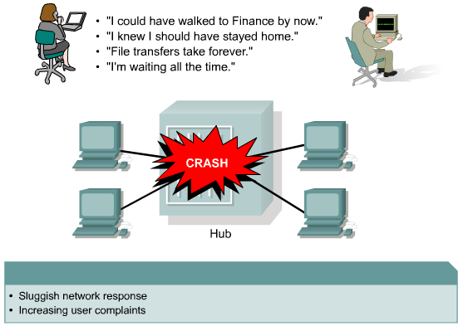
Switches and Collision Domains
The network area where frames originate and collide is called the collision domain. All shared media environments are collision domains.

Slide 24
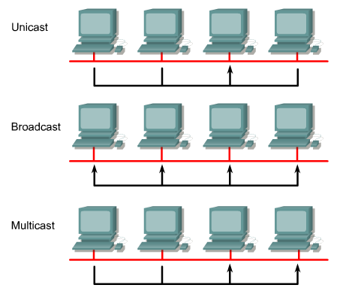
Three Methods of Communication

Slide 25
Switches and Broadcast Domains
Broadcasting is when one transmitter tries to reach all the receivers in the network. The server station sends out one message, and everyone on that segment receives the message.

Slide 26
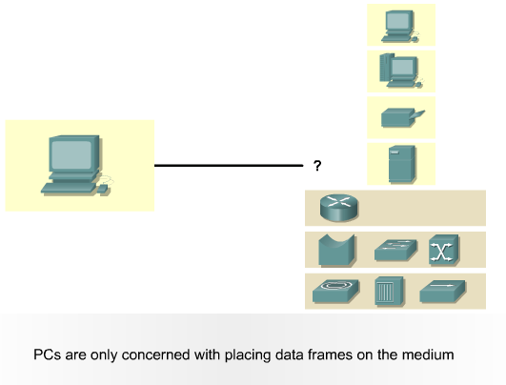
Communication Between Switches and Workstations

Slide 27
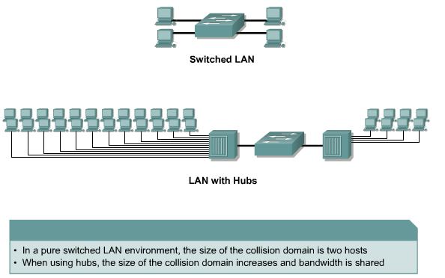
Layer 2 Switch Collision Domains

Slide 28
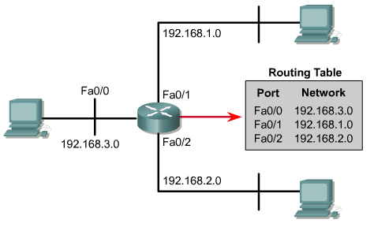
Use Routers to Impose Logical Structure
Routers provide scalability because they serve as firewalls for broadcasts. They can also provide scalability by dividing networks into subnetworks, or subnets, based on Layer 3 addresses.

Slide 29
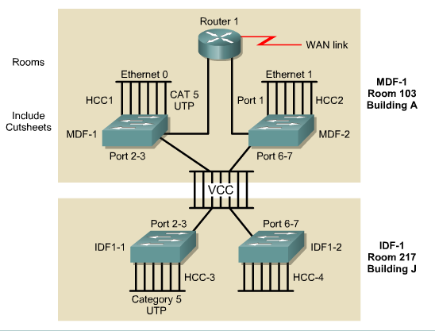
Physical Network Maps

Slide 30
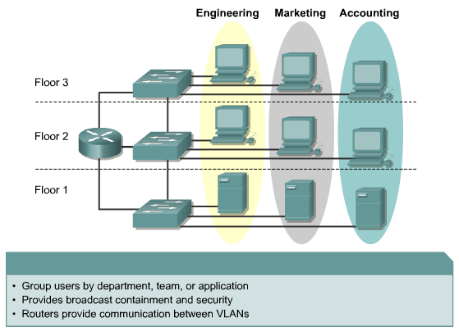
Setting Up VLAN Implementation

Slide 31
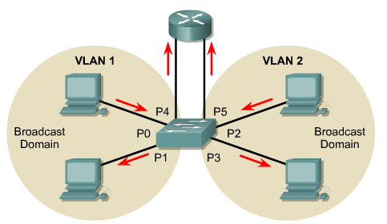
VLAN Communication

Slide 32
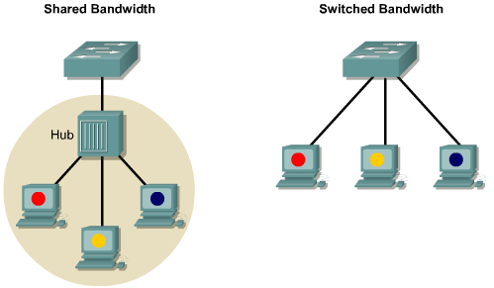
Access Layer

Slide 33
Access Layer
Functions of the Access Layer:
  Shared Bandwidth
  Switched Bandwidth
  MAC Layer Bandwidth
  Microsegmentation

Slide 34
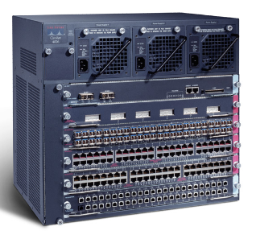
Access Layer Switches
Catalyst 1900 series
Catalyst 2820 series
Catalyst 2950 series
Catalyst 4000 series
Catalyst 5000 series

Slide 35
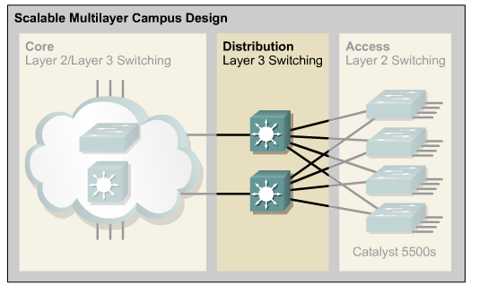
Distribution Layer

Slide 36
Distribution Layer
In a switched network, the distribution layer includes several functions such as the following:
  Aggregation of the wiring-closet connections
  Broadcast/multicast domain definition
  VLAN routing
  Any media transitions that need to occur
  Security

Slide 37
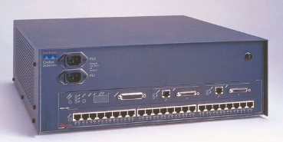
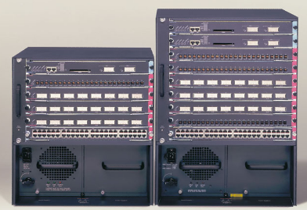
Distribution Layer Switches
Cisco Catalyst 2926G
<not pictured>
Cisco Catalyst 5000 Family
Cisco Catalyst 6000 Family

Slide 38
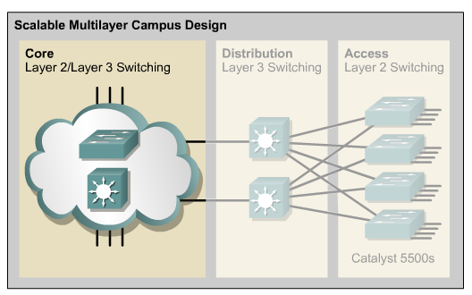
Core Layer
The core layer is a high-speed switching backbone. The core layer should be designed to switch packets as fast as possible.

Slide 39
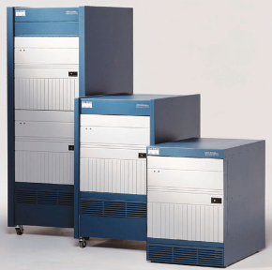
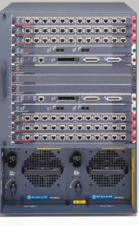
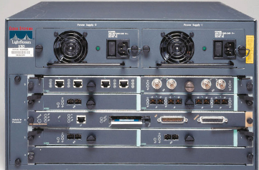
Core Layer Switches
<not pictured>
Catalyst 6500 series
IGX 8400 series
Lightstream 1010
Catalyst 8500 series

Slide 40
Switch Configuration

Slide 41
Objectives
Starting the switch
Configuring the switch

Slide 42
LAN Design Goals
Functionality
Scalability
Adaptability
Manageability

Slide 43
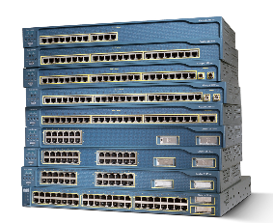
Physical Startup of Catalyst Switches
Switches typically have no power switch to turn them on and off.
They simply connect or disconnect from a power source.

Slide 44
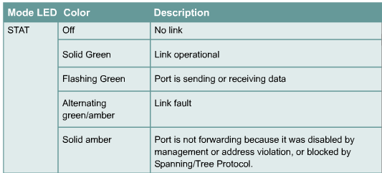
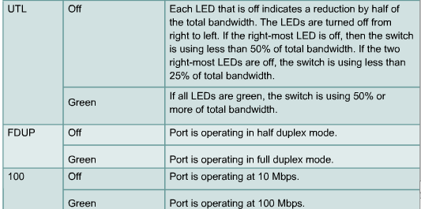
Switch LED Indicators

Slide 45
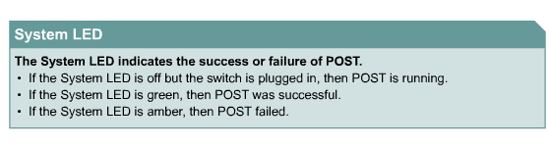
Verifying Port LEDs During Switch POST

Slide 46
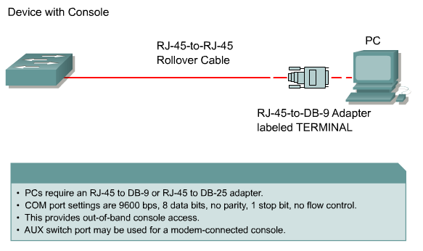
Connecting a Switch to a PC

Slide 47
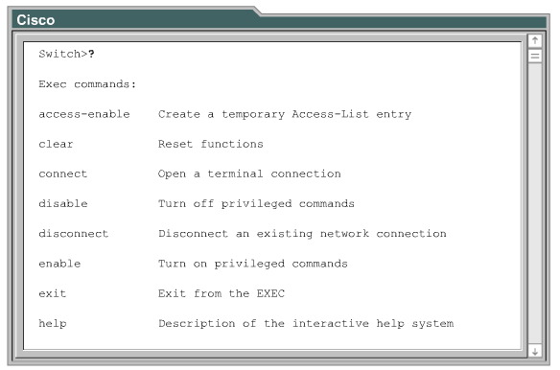
Examining Help in the Switch CLI

Slide 48
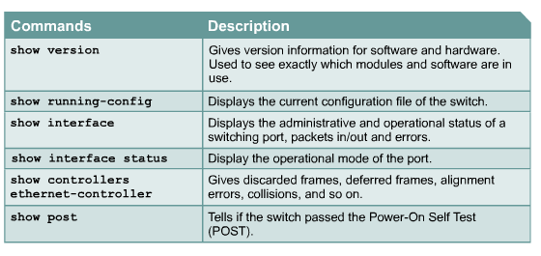
Show Commands in User EXEC Mode

Slide 49
Verifying the Catalyst Switch Default Configuration
show running-config
show interface
show vlan
show flash
show version

Slide 50
Configuring the Catalyst Switch
To overwrite any existing configuration, follow these steps:
  Remove any existing VLAN information by deleting the VLAN database file, vlan.dat from the Flash memory directory.
  Erase the backup configuration file startup-config.
  Reload the switch.

Slide 51
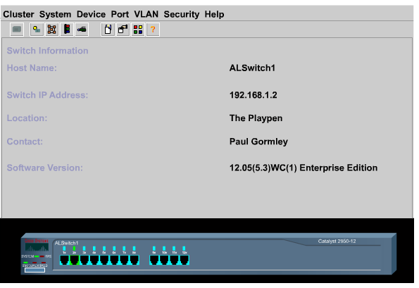
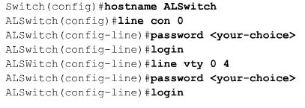
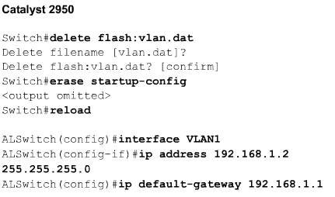
Configuring the Catalyst Switch
Web Management Interface

Slide 52
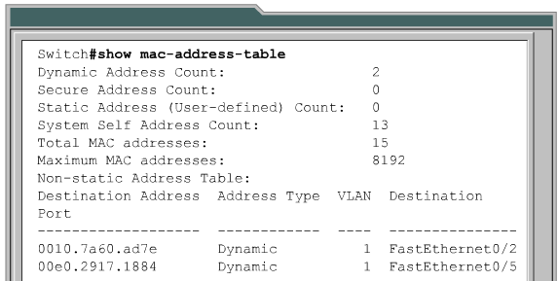
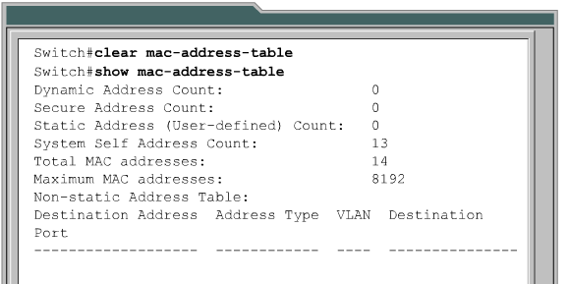
Managing the MAC Address Table
Switches learn the MAC addresses of PCs or workstations that are connected to their switch ports by examining the source address of frames that are received on that port.

Slide 53
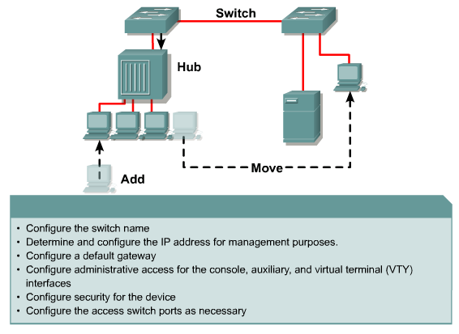
Executing Adds, Moves, and Changes

Slide 54
Managing Switch Operation
An administrator should document and maintain the operational configuration files for networking devices.
The most recent running-configuration file should be backed up on a server or disk.
The Cisco IOS Software should also be backed up to a local server. The Cisco IOS Software can then be reloaded to Flash memory if needed.

